Slide 1
Jet engines (TURBO-JET)
There are several types of engines, but for instance, I am going to explain about Turbofan engine -
1)Where do these engines are used???
-These Engines are mainly used for figter jets, Particularly with low-bypass ratio.
-We have used them in Tejas Mark 1 & 1A by the GE F404-IN20 afterburning turbofan.

Slide 2
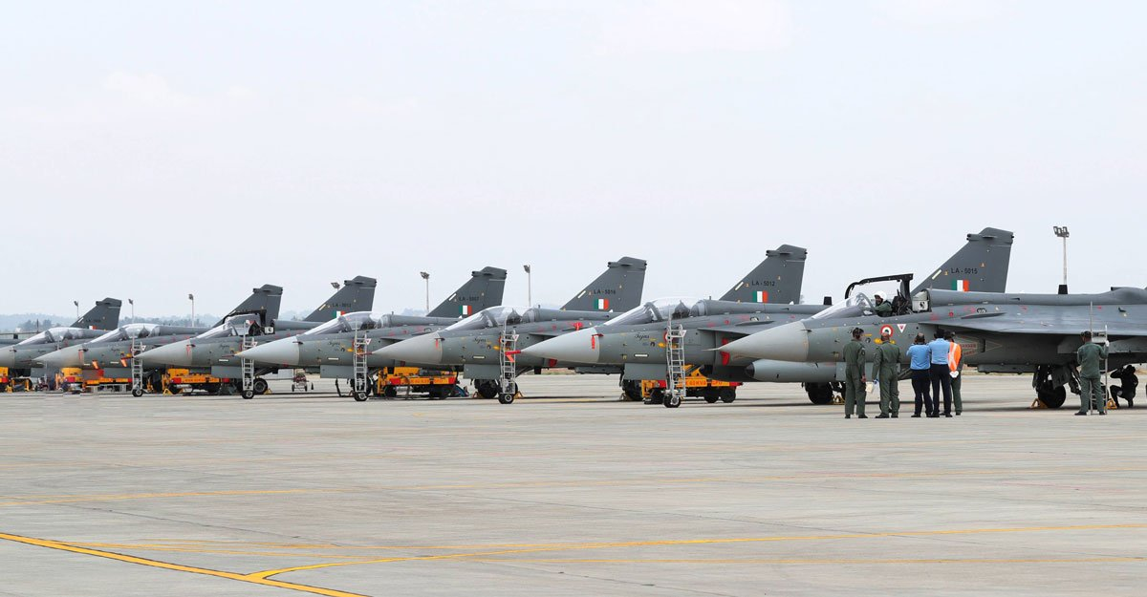
Tejas Jets

Slide 3
Why do we use it ???
Rather than turbo-jet the Turbofan is fuel efficient making it capable for long flight’s.
Due it’s bypassing quality we can directly mix the jet-fuel with engine's hot exhaust gases(After burner’s).
This gives the Jet sudden thrust and manoeuvrability mid-flight.
These makes the foe’s aircraft to re-target, giving us edge during Combat.

Slide 4
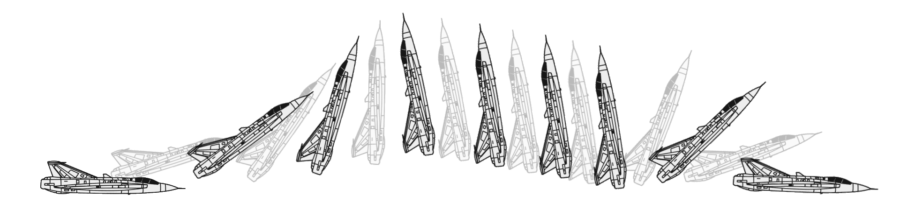
Cobra Maneuver

Slide 5
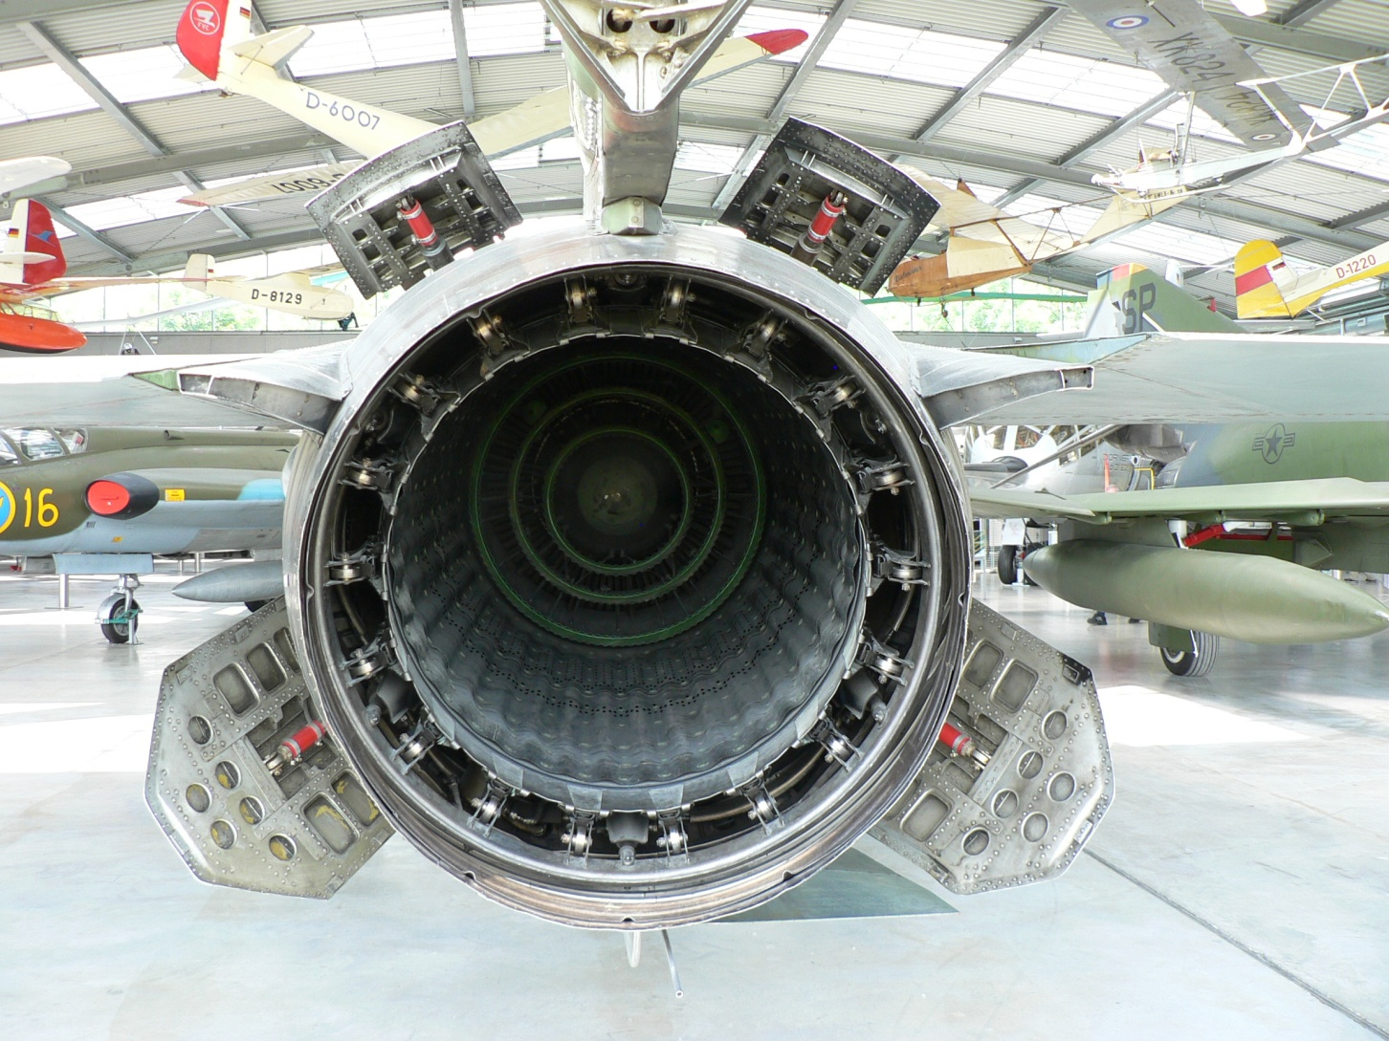
Afterburner of MiG-23

Slide 6
Materials used for building an jet engine.
Making a fighter jet turbofan is not "impossible," but it is extremely challenging because:
The engine must operate at temperatures hotter than the melting point of its metals.
It must be lightweight yet extremely strong.
It must survive immense stresses (20,000–30,000 rpm, supersonic airflow, G-forces).
It must be reliable for thousands of hours under combat conditions.

Slide 7
Compressor Blades are Made from titanium alloys (lightweight, strong at ~400–500°C).
Turbine Blades are made from Single crystal blades(no grain boundaries → prevents creep and fatigue).
Turbine Blades made to with stand the temperatures between 1500–1700°C (hotter than steel melts).
Turbine blades are made of nickel-based superalloys (like Inconel, Rene, CMSX).

Slide 8
Afterburner Materials are Made from nickel alloys + ceramic composites.
Shafts and Casings are made from High-strength steels and titanium.
In some advanced turbofans, fan blades or casings are made from carbon-fiber reinforced composites.
Balancing strength vs. weight vs. toughness is always a material science challenge.

Slide 9
Principle of TurboFan engine

Slide 10
Working Principle
A) Low-Pressure Spool
Contains the fan, low-pressure compressor (LPC), and low-pressure turbine (LPT) connected by a shaft.
The fan and LPC compress incoming air moderately.
The LPT extracts power from hot gases to drive the fan and LPC.
Runs at lower rpm compared to the high-pressure spool but handles large airflow.
B) High-Pressure Spool
Consists of the high-pressure compressor (HPC) and high-pressure turbine (HPT) connected by a shaft.
The HPC compresses air to very high pressure before combustion.
The HPT extracts energy from the hot gases to drive the HPC.
Operates at very high rpm, critical for thrust and efficiency.

Slide 11
C) Stationary Components
Includes stators, vanes, seals, and the casing.
Guide vanes control airflow angle between rotating blades.
Casings provide structure and maintain tip-clearance for efficiency.
Also house accessory gearboxes and support systems.
1) Nacelle
The aerodynamic outer shell covering the engine.
Provides smooth airflow entry into the fan and compressors.
Reduces drag and noise, and may include stealth shaping for fighters.

Slide 12
2) Fan
Large front blades driven by the low-pressure turbine.
Splits airflow into:Bypass flow (cold air) → exits through fan nozzle to produce thrust.Core flow (hot air) → enters compressors, combustor, and turbines.
In fighters, bypass ratio is low (0.3–1) for compact size and supersonic performance.
3) Low-Pressure Compressor (LPC)
Compresses air moderately after the fan.
Increases overall pressure before air enters the HPC.
Built with titanium alloys for strength and light weight.

Slide 13
4) High-Pressure Compressor (HPC)
Multistage compressor that raises pressure up to 20–30 times atmospheric pressure.
Supplies high-pressure air for combustion.
Uses variable stator vanes and bleed valves to prevent stall/surge.
5) Combustion Chamber
High-pressure air is mixed with fuel and ignited.
Temperature rises sharply to ~1500–1700°C.
Annular combustors ensure compact design and stable flame.
Liners are cooled and coated to survive extreme heat.

Slide 14
6) High-Pressure Turbine (HPT)
First turbine stage downstream of the combustor.
Extracts energy to drive the high-pressure compressor.
Made from single-crystal nickel superalloys with ceramic coatings and internal cooling passages.
7) Low-Pressure Turbine (LPT)
Extracts remaining energy from hot gases to drive the fan and LPC.
Operates at slightly cooler temperatures than HPT but handles higher mass flow.
Larger blades, often cooled and coated for durability.

Slide 15
8) Core Nozzle
Expels hot gases from the core stream to produce jet thrust.
Often a variable nozzle in fighters to control back-pressure and efficiency.
Works with afterburner to expand high-energy exhaust gases.
9) Fan Nozzle
Expels the cold bypass airflow.
Adds thrust directly and mixes with hot exhaust to reduce IR signature.
May be fixed or variable depending on design.
👉 Would you like me to also prepare a “10th section: Afterburner” in the same PowerPoint style? Almost all fighter turbofans rely on it for extra thrust in combat, so it will make your PPT more complete.

Slide 16
10) Afterburner (Augmentor)
Located after the turbines, before the exhaust nozzle.
Injects additional fuel into the exhaust stream and ignites it.
Provides a massive thrust boost (up to 50–80%) during combat, takeoff, or supersonic flight.
Equipped with flame holders that stabilize the flame in high-speed exhaust.
Uses a variable-area nozzle to handle increased pressure and prevent compressor stall.
Built with heat-resistant nickel alloys and ceramic coatings to survive temperatures above 2000°C.
Increases thrust but consumes much more fuel, so used only when necessary.
In modern fighters, may also feature thrust vectoring nozzles for supermaneuverability.

